Slide 1



Building a
Financial Tool Web-App
Maine Isasi, Sanjo Joy, Pablo Gallegos,
Margarida Pereira, Isaac Chaljub

Slide 2


We developed an intuitive, easy to use web app that can be accessed from any device at any given moment. Our goal is to democratize access to financial information, which can be intimidating to some people
Project
Overview
We developed a predictive model and an algorithmic strategy tool for the users. Everything runs smoothly in the background using Python while Streamlit integrates the frontend of the project

Slide 3



Data handling
ETL preprocessing was separated in batch and streaming sources, performing cleaning, missing value handling, and merging of the data to serve it in a format that could be used throughout the application.
For the batch data we donwloaded all historical information available on Simfin, while for the streamed data we used their API to call and collect the most recent data available.

Slide 4


Web-App development was carried out using Streamlit, creating a multi-page environment to simplify and integrate all the functionalities devised by the team
We opted to deploy it to Streamlit Cloud on the URL https://financialtool-group3.streamlit.app/. This way we can serve customers around the globe 24/7.
Deployment of the application

Slide 5
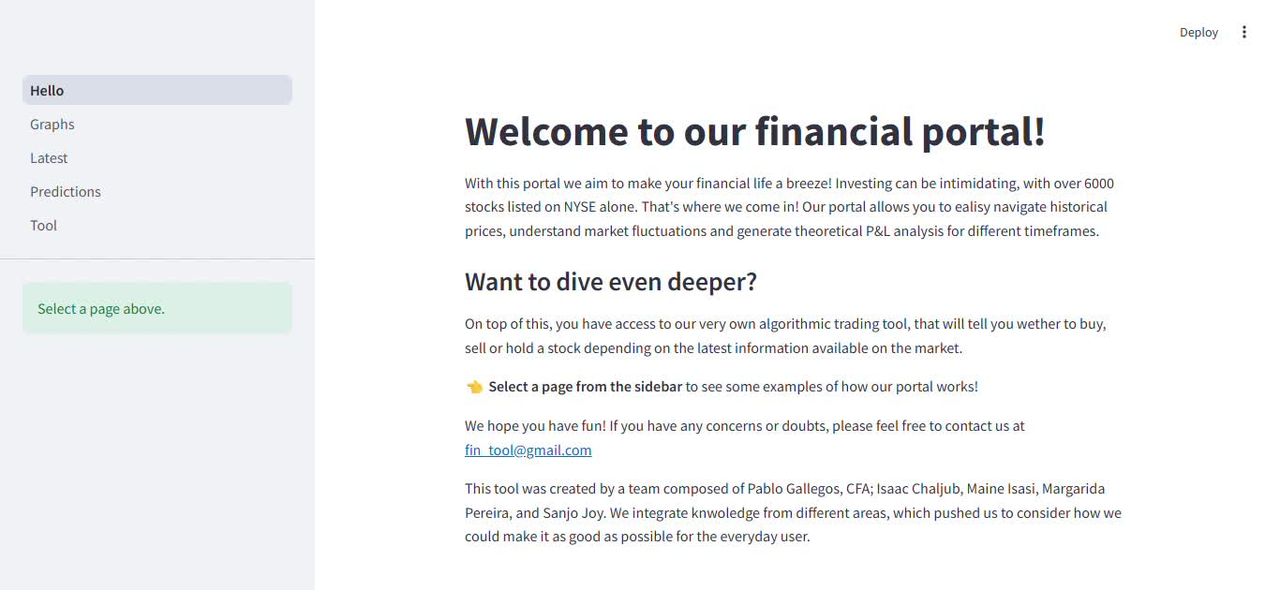

Slide 6

Conclusions
Predicting stocks’ behavior is extremely diffcult, especially considering all the qualitative information that goes into it.
Streamlit and Python offer a free, easy to use and scalable solution to web deployment, opening up endless opportunities on projects.

